Slide 1
Creating Healthy Communities
What works well when it comes to creating healthy communities?

Slide 2
Table of Contents
Key issues
What makes programs work?
Step One
01
02
03
Step Two
Step Three
Step Four
04
05
06
Rural local gov challenges to healthy policy implementation.
What makes a healthy communities program successful; 4 steps.
Setting the foundation.
Preparation.
Planning and implementation.
Reflect, adapt and embed.
Action Plan and Examples
07
Action plan template and real Australian program examples.

Slide 3
Introduction
The role of local government (LG) in improving public health has been given legislative recognition in some Australian states. There is growing evidence of the positive role this recognitiion has given to align LG efforts with state government health policy.
However disparities in health outcomes amongst rural and remote Australian communities show there are challenges to overcome when creating healthy communities in these areas.
We aim to analyse these challenges and determine what works best in creating healthy rural and remote communitites.

Slide 4
Key Issues in implementing public healthy policies
Rural and regional local governments face a few more issues when it comes to public healthy policy implementation than urban governments.
These issues include but are not limited to:
Role of leadership and related political strategies
Diminished funding
Changes in staff or management structures
Changes in political priorities
Lack of access to public health experts with whom to collaborate
Current staff don’t have the capacity to take on extra responsibilities
Constraints on infrastructure and resources
Growth and changes in characteristics of local populations
Expecting non-health focus departments to incorporate health issues into policies could be seen as a departure and distraction from core business

Slide 5
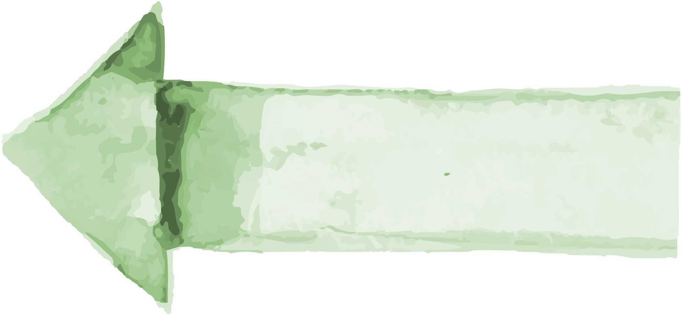
01
02
03
What Makes a Healthy Communities Program Work?
(Adapted from Government of South Australia, 2020)
04
Setting the Foundation
Preparation
Planning and Implementation
Reflect, Adapt, Embed
Find support, identify resources, start conversations.
Plan for community needs, existing mechanisms, sustainability
Make action plan, find barriers, decide engagement techniques
Reflection and brainstorming.

Slide 6
STEP 1: Setting the Foundation
Leadership support
- Establish a level of commitment from necessary managers
- Do existing policies and procedures support what you’re looking to achieve?
Community support
- Identify existing and potential partners (e.g. local businesses, NGO’s)
Identify resources
- Financial resources
- Time
- Potential grant funding
- In-kind support
- Existing communication mechanisms with community (e.g. email, newsletters)
Start conversations
- How do the various parties involved interact to support or limit community
health and wellbeing?
Draw connections
- What diverse perspectives might other stakeholders bring?
Asset-based community design
- What strengths/assets does your community have? How can they be used?
- May include social connections, infrastructure, natural resources, education, etc

Slide 7
STEP 2: Preparation
Regional public health and other relevant council plans
- What actions, needs and opportunities are in highlights in Council plans; how
might you build on these?
Community needs and priorities
- Are the planned actions desirable for those affected/targeted?
- Would greater consultation/certainty by helpful?
Use existing mechanisms
- How would you facilitate collaboration between individuals and organisations?
Plan for sustained improvements
- Will the change meet an identified need?
- Is it as simple and accessible as possible?
- Is it ‘trial-able’?
- How can you share its success?
Success planning
- How will you know if you’ve achieved your goal?
- Have a way to measure positive changes in your system

Slide 8
STEP 3: Planning and Implementation
Barriers
Accountability
What strategies will address possible barriers?
Engagement
Action Plan
Who will be responsible for follow through within the timeframe?
How to get community involved or informed?
Adaptability
Identify what you will do, with whom, and when
Make ongoing monitoring and feedback flexible

Slide 9
STEP 4: Reflect, Adapt and Embed
Reflecting
Brainstorm with others
What is the data telling you about the scale of change?
What feedback have you received?
Were there changes you didn’t expect?
Discuss development, implementation and evaluation with your team and community
What would you do differently?
Adapt
Embed
If your changes haven’t been fruitful or something has changed in your community, then return to step 3 and review.
How can you sustain positive change by embedding with local government policies?
How can you encourage community members to share their experiences?

Slide 10
Example of Action Plan

Slide 11
Australian Healthy Communities Programs: Example 1
Promoting active lifestyles
Link: http://www.activehealthycommunities.com.au/wp-content/uploads/2014/07/QH37_AHC_Mackay.pdf

Slide 12
Promoting active lifestyles
What it demonstrates:
Benefits of interdepartmental partnerships within councils.
The program seeks to accommodate working habits of the local community.
Links programs that are driven by different goals to increase better outcomes (e.g. improved physical health and economic development).
Links a range of council objectives and goals to improve access to resources.

Slide 13
Promoting active lifestyles
Program details:
Action 1
Action 2
Action 3
Identified physical activity programs (PA) to bring people back to Mackay CBD.
Used existing council levy on local CBD traders to fund projects in their economical interest.
Sought out local providers and trainers to run activities.
Goal
Increase custom of local business in CBD and improve physical health of residents and visitors.
Action 4
Action 5
Action 6
Provided free exercise activities in CBD for past 3 yrs.
Relaunched program when new activities added, with Councillors, sponsors and media.
Acknowledged work of PA providers with a morning tea with Mayor and Councillors.

Slide 14
Australian Healthy Communities Programs: Example 2
Improving local food supply
Link: http://www.activehealthycommunities.com.au/wp-content/uploads/2014/07/QH37_AHC_Maranoa.pdf

Slide 15
Improving local food supply
What it demonstrates:
Aims to improve access to accredited nutrition and physical activity programs.
Targeted responses for at-risk groups (e.g unemployed, aged and stay-at-home parents).
Whole-of-community approach to creating supportive environments.
Importance of council workplaces being a role model for other businesses.

Slide 16
Improving local food supply
Program details:
Action 1
Action 2
Action 3
Offers free activities, including: cooking workshops, nutrition sessions and shopping tours.
Provides short course for catering business to provide healthy food and drink choices.
Developed maternal and infant nutrition workshops on Saturdays.
Goal
Improve access to accredited nutrition and physical activity programs, and to encourage people to take steps to improve their health and wellbeing.
Action 4
Action 5
Action 6
Developed resources to identify healthy food options.
Chose community ambassadors who represent target groups to promote the program.
Evaluation methods: Point-of-sale surveys, online survey of council staff, face-to-face interviews with caterers

Slide 17
Australian Healthy Communities Programs: Example 3
Link: https://queenslandwalks.org.au

Slide 18
References
Active Healthy Communities. (2013a). Active in the City: Mackay Regional Council. http://www.activehealthycommunities.com.au/wp-content/uploads/2014/07/QH37_AHC_Mackay.pdf
Active Healthy Communities. (2013b). Go Green: Maranoa Regional Council. http://www.activehealthycommunities.com.au/wp-content/uploads/2014/07/QH37_AHC_Maranoa.pdf
Baldwin, L, Dallaston, E, Bennett, B, McDonald, F, Fleming, ML. (2021). Health in all policies for rural and remote health: A role for Australian local governments? Aust J Publ Admin, 1-8. https://doi.org/10.1111/1467-8500.12460
Cancer Council WA. (2010). Partnerships for building healthy communities. Working with local government to help prevent cancer and other chronic disease in Western Australia. https://www.cancerwa.asn.au/resources/2010-12-07-Partnerships-for-Building-Healthy-Communities-Monograph.pdf
Local Government Association of Queensland (LGAQ). (2013). Healthy communities project. Retrieved from http://www.activehealthycommunities.com.au/
Marshall, N. (2010). Restructuring and reform: Australia. In (E. Brunet-Jailly and J. F. Martin Eds.), Local government in a global world (pp. 81–107). Toronto, Canada: University of Toronto Press.
Government of South Australia, Wellbeing SA. (2020). Local Government Community Health and Wellbeing Toolkit. https://www.sahealth.sa.gov.au/wps/wcm/connect/2b694b6c-562e-4f67-85c9-ab15b0b17656/20109.1+CHW-Toolkit-2020-V2.pdf?MOD=AJPERES&amp;CACHEID=ROOTWORKSPACE-2b694b6c-562e-4f67-85c9-ab15b0b17656-nwKtVOj

